Slide 1

DriverPass
System Analysis
Henrietta Batson
Notes:
[No speaker notes required for this slide.]

Slide 2

System Requirements
Core System Features (Functional):
  Allows students to easily book, modify, or cancel their own driving lessons online.
  Provides online learning portals with instructional video access and practice tests.
System Performance Rules (Nonfunctional):
  Runs entirely online in the cloud so it works seamlessly on both computers and mobile phones.
  Automatically pulls in updates from the DMV system in the background without slowing down the site
Notes:
When looking at what DriverPass needs to succeed, we divided the goals into two main buckets. First, we focused on the core features, like giving your students a self-service dashboard to handle their own lesson bookings, changes, and test prep without needing to call the office. We also made sure the office secretary has a dedicated screen to quickly register phone-in customers. Second, for the system rules, we ensured the platform runs entirely online in the cloud so it updates instantly when the DMV pushes out new test information, keeping your data accurate and lag-free.

Slide 3
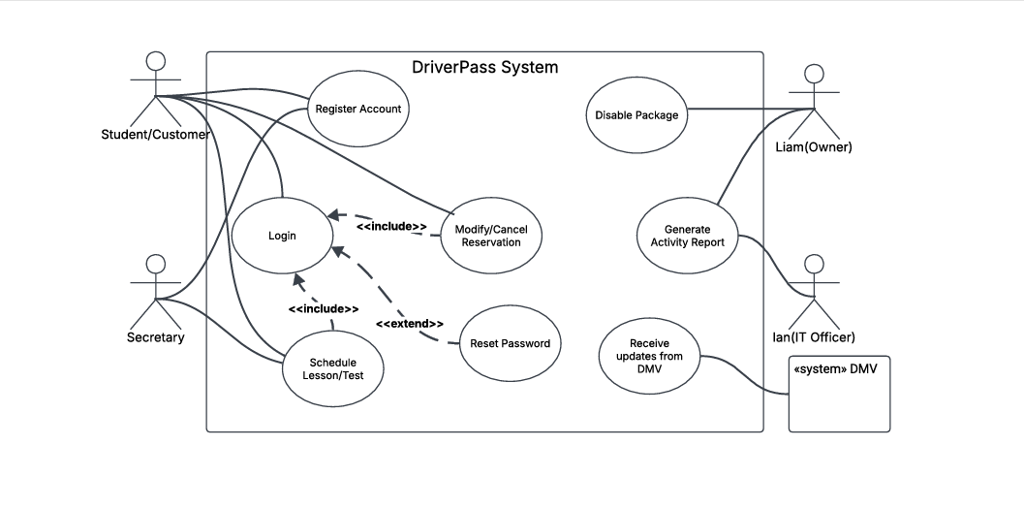
Use Case Diagram
Notes:
This diagram acts as our map to show who uses the software and what actions they can take. We have mapped out specific lanes for different roles. Students can handle bookings, the secretary manages office help, Liam can instantly pause packages if slots are full or print business reports, and Ian has full security access to manage employees. This keeps the application incredibly safe because it builds a hard digital wall between basic customer options and your internal business records.

Slide 4
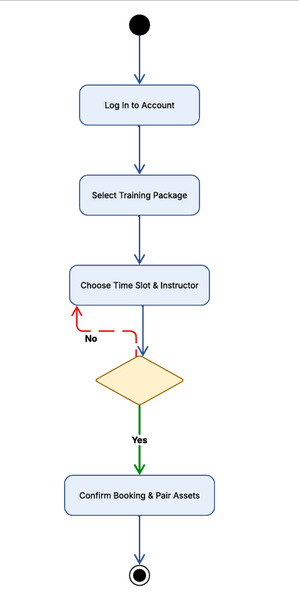
Activity
Diagram
Notes:
This flowchart shows the exact step-by-step path a student takes when they want to book a behind-the-wheel lesson. The system guides them from logging in, to selecting a package, down to picking a time. The most important part here is the center checkpoint. The system automatically cross-references your 10 cars and 10 drivers in the background. If a slot is open, it matches them instantly. If a slot is full, the system gently loops the customer back to pick another open slot, preventing messy scheduling mistakes or double-bookings.

Slide 5
Security
Account Protection: Unique usernames and passwords are required for all accounts.
Hacker Protection: Automatic lockouts and alerts trigger if a password is guessed incorrectly multiple times.
Master Key Access: Complete administrative override control for the IT role to instantly remove fired workers.
Data Privacy: Encrypted cloud pathways protect credit card numbers and personal addresses.
Notes:
Security is a top priority for protecting your business and your customers' trust. Every user gets a unique login, and if someone tries to brute-force guess a password over and over, the software automatically locks the account down to prevent hacking. We have also included a Master Key feature for Ian, allowing him to immediately block old employees from logging in without needing to rewrite any website code. Finally, all sensitive inputs like credit card info are encrypted safely in the cloud so they can never be intercepted.

Slide 6
System Limitations
Internet Dependency: Users must be actively online to book or change a lesson.
No Coding Access for Staff: Standard office workers can only use pre-built menu settings.
Fleet and Driver Constraints: The system hard-caps scheduling to 10 concurrent lessons based on physical company assets
Notes:
To keep expectations realistic, every system has natural boundaries. First, because the platform relies on a live master calendar to prevent duplicate entries, users cannot manage reservations while offline. Second, regular staff members cannot modify how the website functions; they can only interact with the clear dashboard menus pre-built for them. Lastly, the software is strictly constrained by your real-world resources, meaning it hard-caps active bookings to 10 lessons at any single time because you currently have 10 cars and 10 drivers available.

